Slide 1
Automatic Plant Watering System
Course Code: | EEE 2104 | Course Name: | Electronic Devices Lab
Course Teacher: Md. Ashiquzzaman
Assistant Professor
Department of Electrical and Electronic Engineering
SL # | Students ID | Students Name | Program | Section
1 | 22-49451-3 | SUPPRIO SAHA PRANTO | BSc in CSE | N
2 | 22-48091-2 | MOHAMMED SAIFUL ISLAM | BSc in CSE | N
3 | 22-47997-2 | ABDULLAH AL MARUF | BSc in CSE | N
4 | 22-48108-2 | AHBAB SAKLAN | BSc in CSE | N
5 | 22-49304-3 | DIP SARKAR | BSc in CSE | N

Slide 2



Outline of the Presentation
Objectives 3
Introduction 4-6
Literature Review 7-8
Description of the Work 13-19
Results and Discussions 20-22
Conclusions 23
Future Works 24
Working Method 9-12

Slide 3
Objectives of the Work
To develop an automatic watering system that optimizes water usage for plant care. By accurately sensing soil moisture and delivering water only when needed, the system aims to reduce water wastage and promote efficient water resource management.
To provide a convenient solution for plant owners by automating the plant watering process. The system should enhance the health and well-being of plants by ensuring they receive the right amount of water at the right time, thus reducing the risk of overwatering or underwatering.
To create a user-friendly and sustainable automatic watering system. It should be easy to install, operate, and maintain. Additionally, the system should promote sustainable gardening practices by conserving water and reducing the environmental impact of plant care.

Slide 4
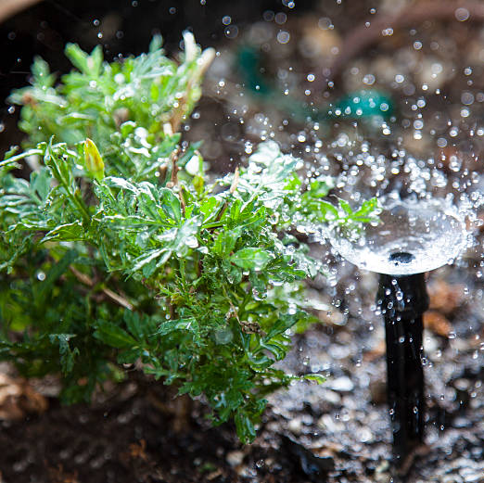
Introduction
Background:
Growing urbanization impacting green spaces.
Increasing desire for personal and community gardens.
Maintenance challenges hinder widespread adoption.

Slide 5
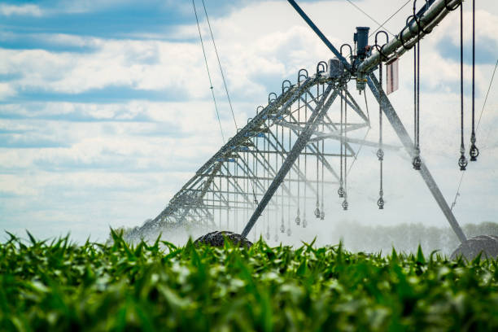
Introduction
Motivation:
Simplifying plant care for individuals with busy lifestyles.
Addressing resource conservation and water efficiency.
Aligning with the broader theme of environmental sustainability.

Slide 6
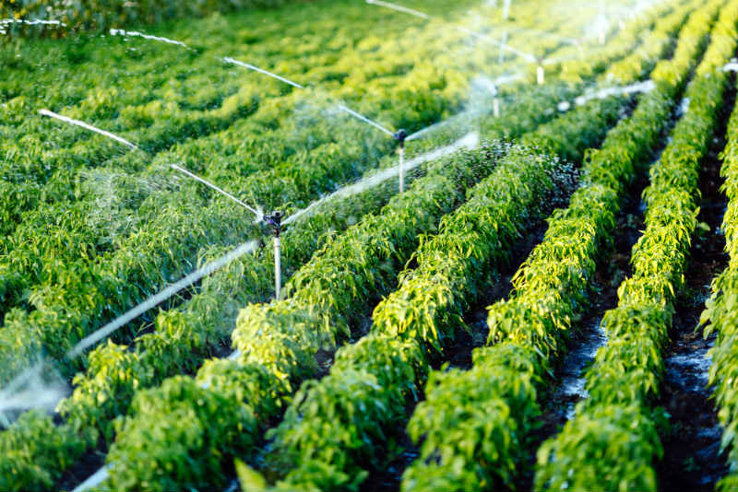
Introduction
Significance:
Evolving agriculture parallels the need for innovation in plant care.
Potential to mitigate water scarcity through intelligent water management.
Balancing technological progress with environmental stewardship.

Slide 7
Literature Review
IoT-Based Smart Irrigation Systems:
Integration of sensors, microcontrollers, and connectivity options.
Arduino's compatibility with IoT for remote monitoring and control.
Example: Kumar et al. (2019) IoT-based system with Arduino, allowing soil monitoring and remote control via a smartphone app.
Sensor Technologies for Soil Moisture Monitoring:
Critical role of soil moisture sensors in automatic irrigation.
Various sensor types compatible with Arduino: capacitance-based, resistive, TDR.
Example: Muthukumaran et al. (2018) assessed sensor performance in Arduino-based system across different soil types.
Weather Data Integration:
Importance of real-time weather data for informed irrigation decisions.
Arduino-based projects incorporating weather data from online sources or additional sensors.
Example: Zheng et al. (2017) integrated local weather station data into an Arduino system for optimized irrigation schedules.

Slide 8
Literature Review
Wireless Communication and Control:
Utilization of wireless communication protocols (Wi-Fi, Bluetooth, LoRa) with Arduino.
Enables remote control and monitoring of irrigation systems.
Example: Gupta et al. (2020) developed a LoRa-based irrigation system with Arduino for extended communication range in remote agricultural settings.
Energy Efficiency and Power Management:
Crucial role of power management for sustainability in automated irrigation systems.
Research focus on reducing power consumption and enhancing energy efficiency.
Example: Kang et al. (2016) designed a solar-powered Arduino irrigation system for continuous operation in off-grid location.

Slide 9
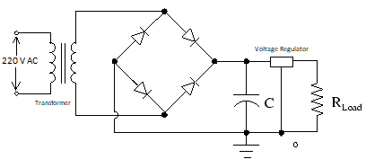
Working Method
Circuit Design:*
- Connect a 220V to 9V step-down transformer to provide a 9V AC supply.
- Use a bridge rectifier to convert the AC to DC.
- Connect a 470uF capacitor as a filter to smoothen the rectified DC voltage.
- Connect a 6V Zener diode as a voltage regulator to regulate the voltage for the Arduino and pump.
Fig-1: Power Supply Circuit Design

Slide 10
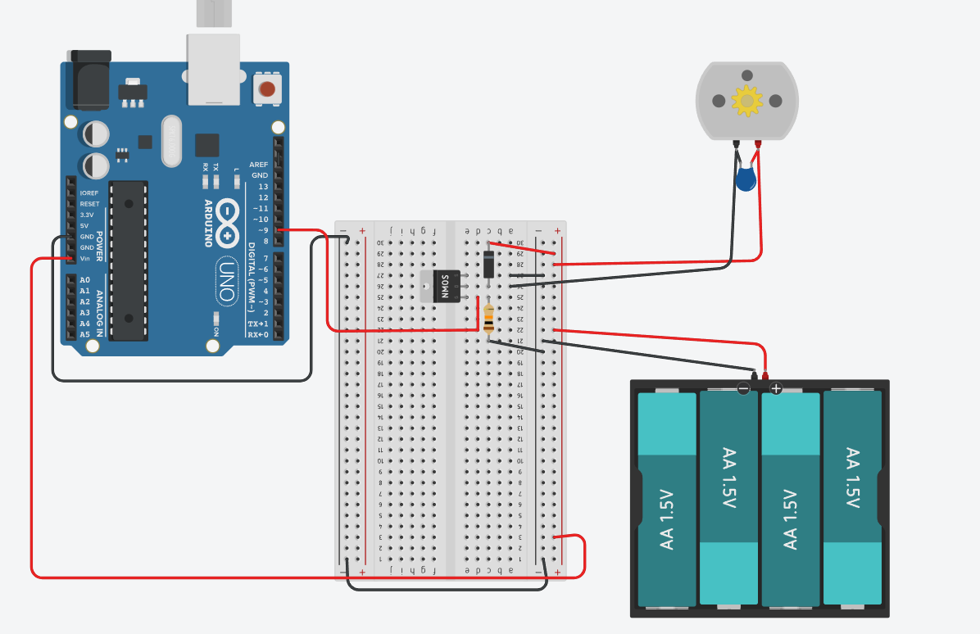
Power Supply Connection:
- Connect the regulated 6V DC output to the power input of the Arduino Uno R3 and the pump.
MOSFET Switch Connection:
- Connect the MOSFET gate to a digital pin on the Arduino.
- Connect the MOSFET drain to the negative terminal of the pump.
- Connect the MOSFET source to the ground.
-Connect a resistor and a Diode to the gate of the transistor and to the Drain.
Fig-2: Main Circuit Design
…

Slide 11
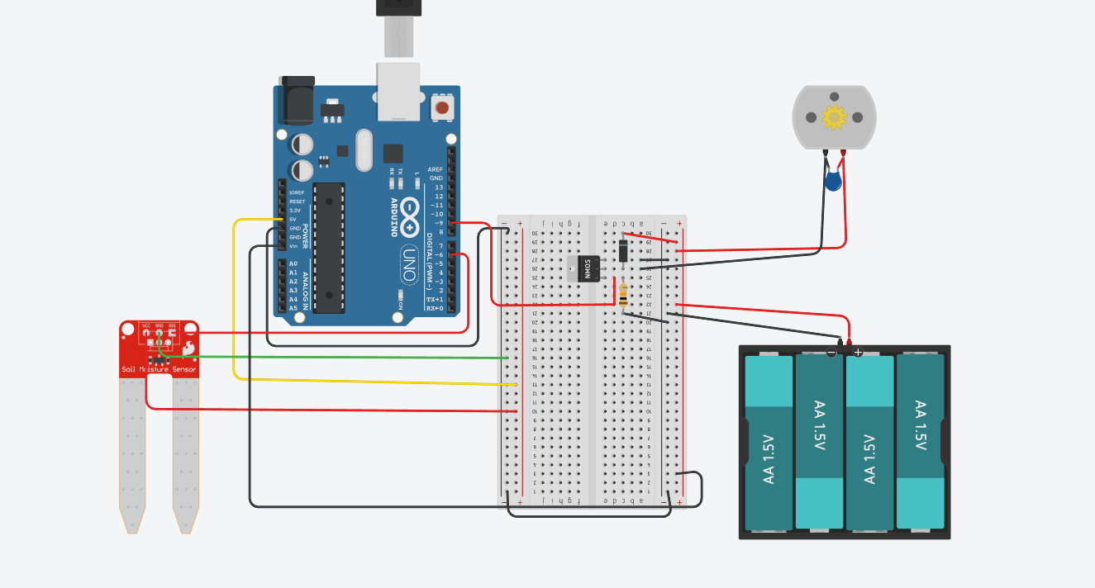
Soil Moisture Sensor Connection:
- Connect the soil moisture sensor to an Digital pin on the Arduino.
- Connect the other pins of the soil moisture sensor to power (Vcc) and ground (GND) Of the Arduino.
Pump Connection:
- Connect the negative terminal of the pump to the drain of the MOSFET.
- Connect the positive terminal of the pump to the positive terminal of the power source.
Fig-3: Main Circuit Design
…

Slide 12
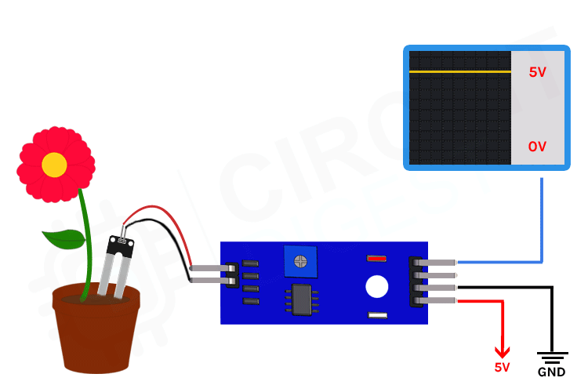
Arduino Programming:
- Write Arduino code to read the soil moisture level from the sensor.
- Implement a control algorithm to determine when to activate the pump based on soil moisture readings.
- Use the digitalWrite() function to control the MOSFET gate, turning the pump on and off.
Soil Moisture Monitoring:
- Arduino continuously reads the soil moisture level using the sensor.
- If the moisture level falls below a predefined threshold, the Arduino activates the MOSFET, turning on the pump.
Pump Activation:
- When the pump is activated, water is delivered to the plants.
- The pump remains active until the soil moisture level rises above the threshold.
Fig-4: Soil Moisture Monitoring

Slide 13
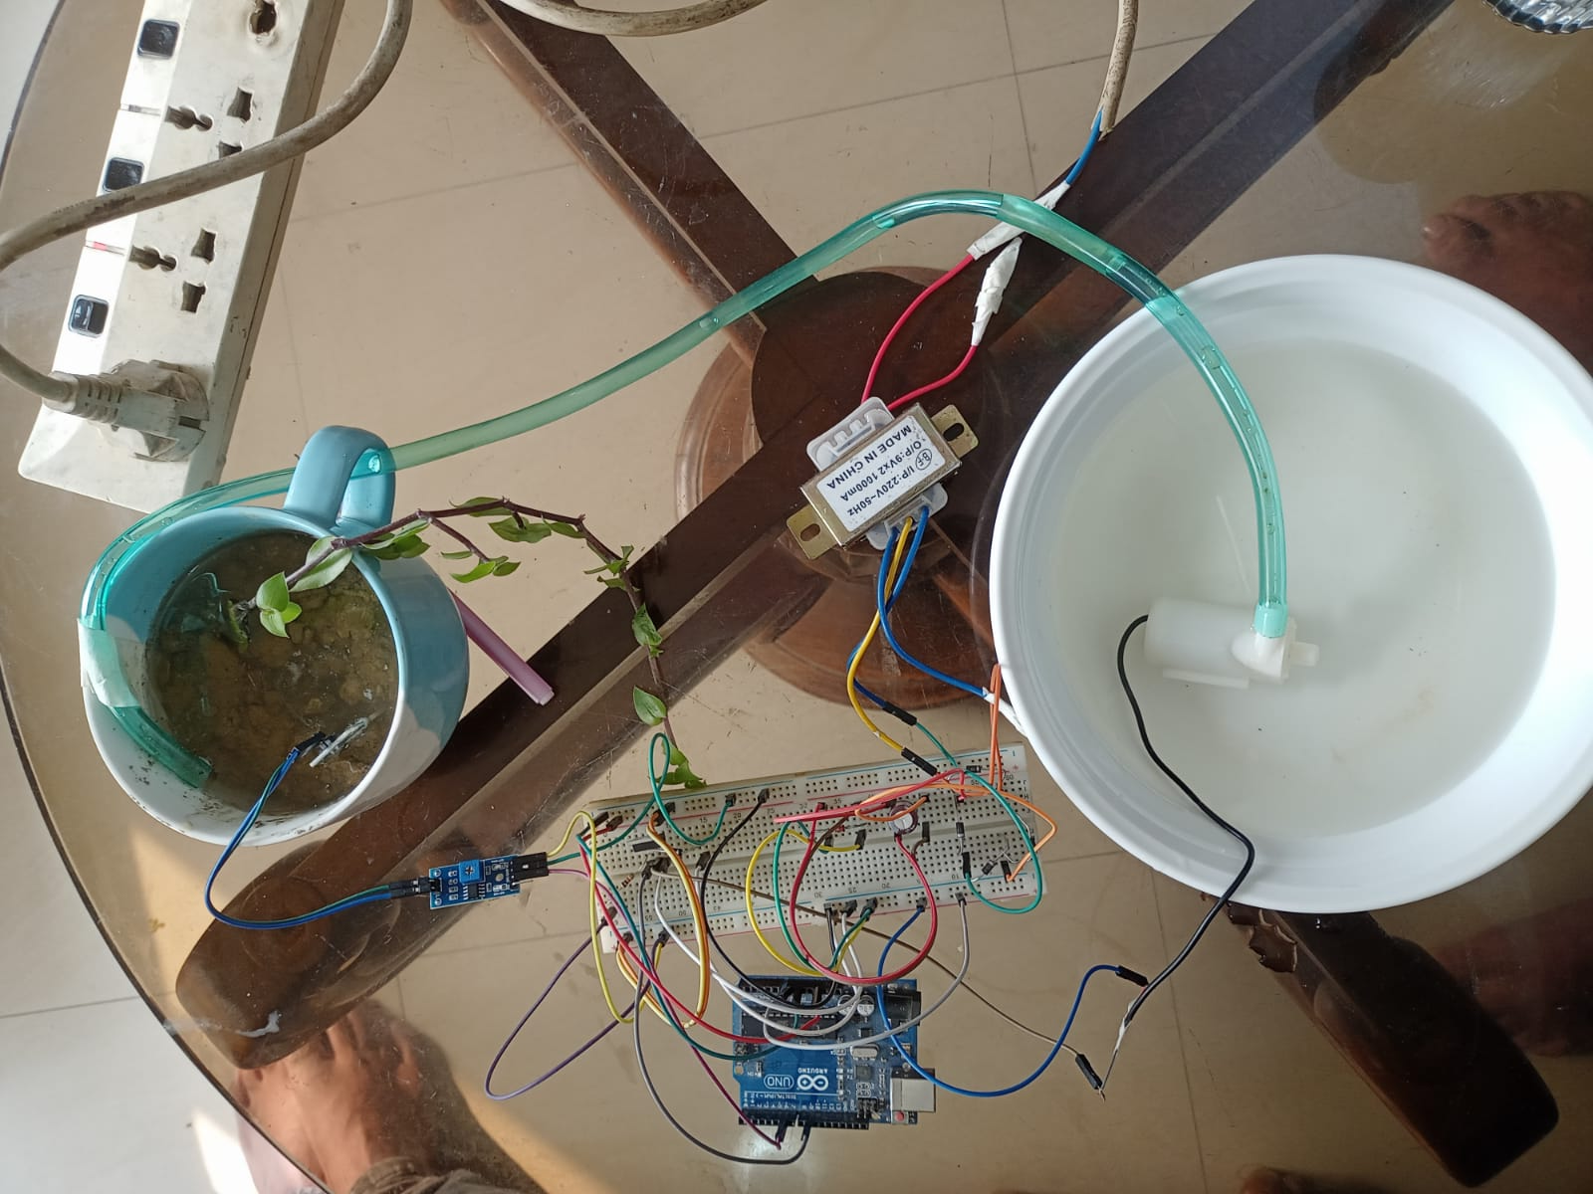
Description of the Work
Overview:
This project aims to create an efficient and automated plant watering system using Arduino Uno R3, a MOSFET as a switch, and a regulated power supply derived from a 220V to 9V step-down transformer.
The system monitors soil moisture levels and activates a water pump to ensure optimal watering conditions for plants.
Fig-5: Circuit Implementation
…

Slide 14
Description of the Work
Components:
Name | Model | Qty
Arduino | Uno R3 | 1
MOSFET | IR F540(N channel) | 1
Transformer | 220V to 9V Step-Down | 1
Silicon diode | 1N4007 | 5
Capacitor | 470uF, 47pF | 2
Zener Diode | 1N4734 | 1
Soil Moisture Sensor | Soil Hydrometer Humidity Detection Module | 1
Water Pump | Mini Submersible DC pump | 1
Resistor | 10k | 1
Various connecting wires | Male to Male ,Male to Female | 20 Approx
Breadboard | - | 1
Fig-5: Circuit Implementation
Table-1: Components
…

Slide 15
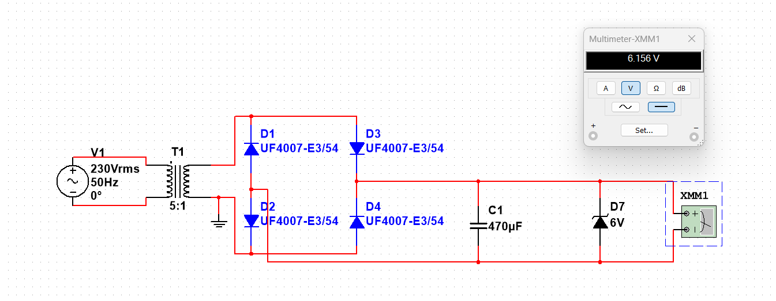
Circuit Design:
- The 220V AC supply is stepped down to 9V AC using a transformer.
- A bridge rectifier converts AC to DC, and a 470uF capacitor filters the DC voltage.
- A 6V Zener diode regulates the voltage, providing a stable 6V DC supply for the Arduino Uno R3 and the water pump.
- A MOSFET, controlled by a digital pin on the Arduino, acts as a switch to control the pump based on soil moisture readings.
Fig-6: Power supply Circuit Simulation
…

Slide 16
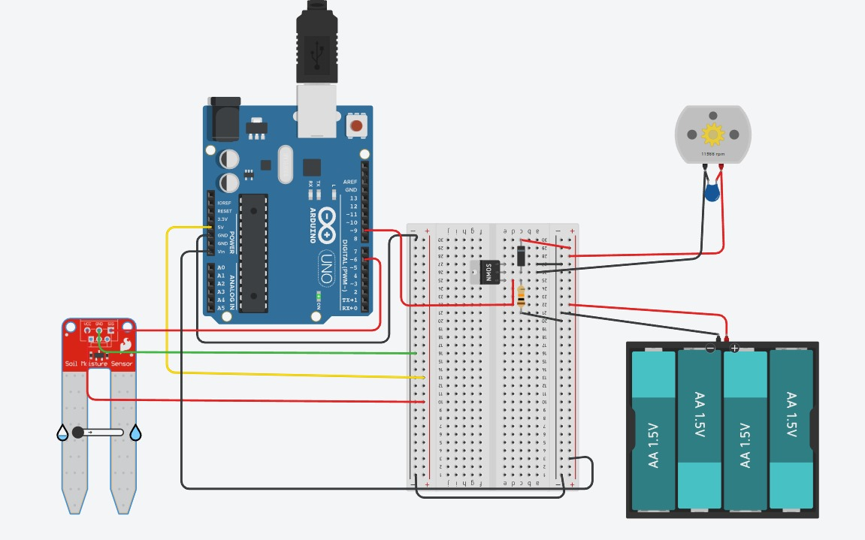
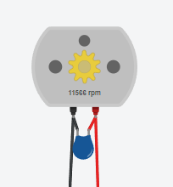
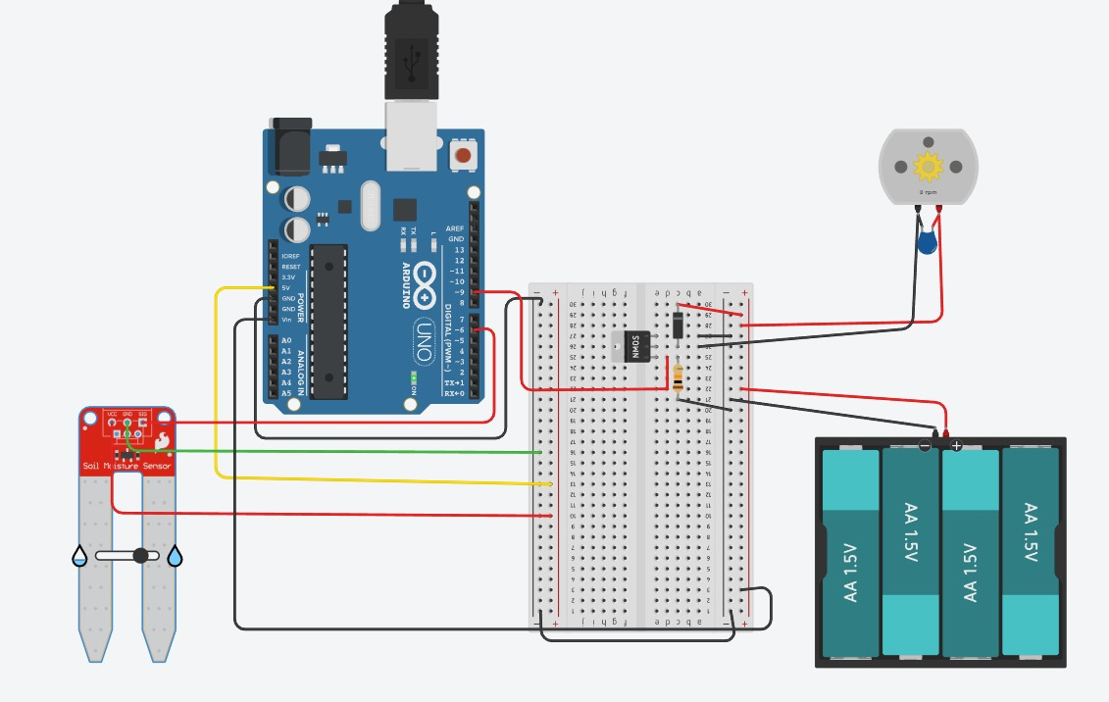
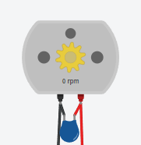
Functionality:
Power-On Sequence:
- Upon power-up, the regulated 6V supply initializes the Arduino and powers the water pump.
Soil Moisture Monitoring:
- The soil moisture sensor continuously measures the moisture level in the plant's soil.
Decision Making:
- Arduino processes the soil moisture readings and activates the MOSFET when the moisture falls below a predefined threshold.
Pump Activation:
- The MOSFET, acting as a switch, turns on the water pump.
- The pump delivers water to the plants until the soil moisture level rises above the threshold.
Fig-7 & 8 : Functionality Simulation
…

Slide 17
Fixing back emf and electrostatic fields :
- We use a silicon diode and connect it between the drain terminal of the MOSFET and the positive terminal of the power source to Control the Back emf of the Motor.
- Without a grounding resistor, the gate resistance to ground is a good approximation of infinity. The MOSFET could respond to any stray electrostatic fields - essentially its state would be uncertain. A high value resistor to ground fixes its state without requiring much current to drive the device.
Fig-9: Fixing back emf and electrostatic fields
…

Slide 18
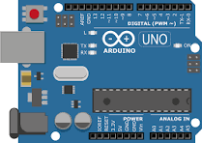
Arduino Code:
int moisture; //random variable
void setup() {
pinMode(9,OUTPUT); //output pin for MOSFET Switch, this will sent signal to the MOSFET Switch
pinMode(6,INPUT); //input pin coming from soil sensor
}
void loop() {
moisture = digitalRead(6); // reading the coming signal from the soil sensor
if(moisture == HIGH) // if water level is LOW
{
digitalWrite(9,LOW); // then Turn on the Switch
}
else // if water level is High
{
digitalWrite(9,HIGH); //then Turn Off the Switch
}
delay(400);
}
Fig-9 : Arduino Uno R3
…

Slide 19
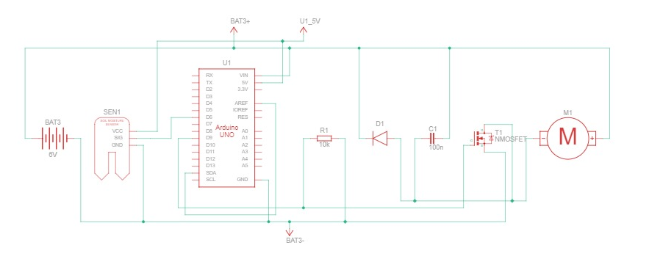
Schematic View:
Fig-10 : Schematic View

Slide 20
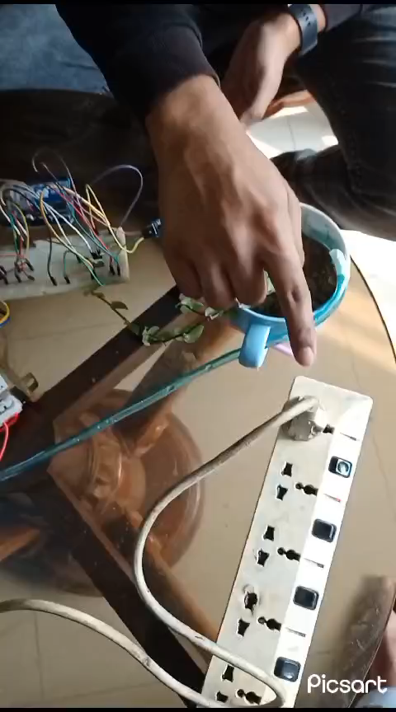
Results and Discussions
Video-1:Result and Explanation
…

Slide 21
Cost Calculation:
Name | Model | Qty | Price
Arduino | Uno R3 | 1 | 789*1
MOSFET | IR F540(N channel) | 1 | 49.8*1
Transformer | 220V to 9V Step-Down | 1 | 229*1
Silicon diode | 1N4007 | 5 | 1.99*5
Capacitor | 470uF, 47pF | 2 | (5*1)+(1.5*1)
Zener Diode | 1N4734 | 1 | 3.29*1
Soil Moisture Sensor | Soil Hydrometer Humidity Detection Module | 1 | 140.6*1
Water Pump | Mini Submersible DC pump | 1 | 199.9*1
Resistor | 10k | 1 | 1.99*1
Various connecting wires | Male to Male ,Male to Female | 20 Approx | 3*20
Breadboard | - | 1 | 88.8*1
 |  | Total Cost: | 1578.83 TK
Table-2: Cost Calculation
…

Slide 22
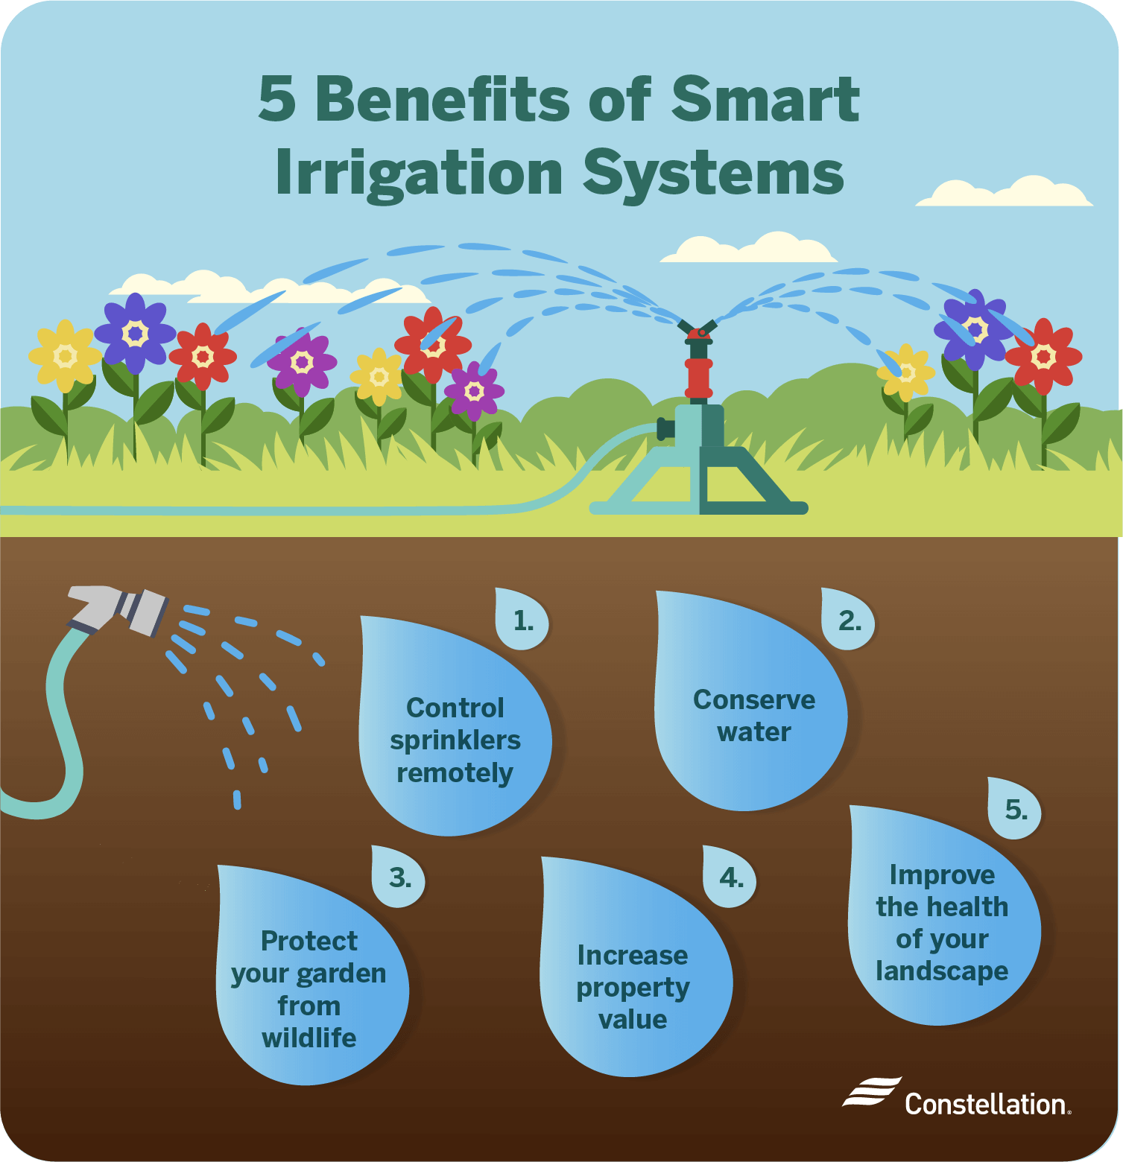
Advantages of Automation:
Precision Watering: The system allows for precise control over watering by dynamically adjusting to the moisture needs of the plants. This prevents overwatering or underwatering, promoting plant health.
User-Friendly Operation: Automation reduces the need for manual intervention in plant care, making it user-friendly and suitable for both hobbyists and experienced gardeners.
Energy Efficiency: The use of a MOSFET switch controlled by the Arduino enables energy-efficient operation. The pump is activated only when necessary, conserving energy and resources.
Fig-11 : Benefits Of Automatic Watering system
…

Slide 23
Conclusions
Automated Watering System Benefits:
Efficient Water Resource Management: Utilizes moisture sensing to optimize water usage, reducing wastage.
Convenience and Plant Health: Ensures plants receive adequate water, promoting health by preventing over/underwatering.
User-Friendly and Sustainable Design: Promotes ease of use, maintenance, and sustainable gardening practices.
Technological Advancements in Automated Irrigation:
Integration of IoT: Enables remote monitoring and control, enhancing irrigation efficiency.
Diverse Sensor Technologies: Provides real-time soil moisture data for optimized irrigation.
Weather Data Integration: Utilizes real-time weather forecasts to schedule irrigation effectively.
Wireless Communication and Energy Efficiency: Facilitates remote control and ensures sustainability through energy-efficient solutions.
These advancements showcase the potential for automated irrigation systems to revolutionize water management in agriculture. Integrating technologies like IoT, diverse sensors, weather data, and energy-efficient solutions offers promising avenues for future research and innovation in this field.

Slide 24
Future Scopes
Refinement and Expansion of Sensor Capabilities
Advanced Sensor Algorithms: Develop algorithms to interpret sensor data more accurately, accounting for diverse soil conditions and plant types for precise irrigation.
Multifunctional Sensors: Explore sensors that not only detect soil moisture but also other crucial parameters like nutrient levels or disease indicators for comprehensive plant care.
Integration and Automation Advancements
Machine Learning Implementation: Investigate machine learning models to predict watering needs based on historical data, enhancing the system's predictive capabilities.
Automation Customization: Develop customizable settings for different plant species or growth stages, allowing tailored watering schedules.
Interdisciplinary Research and Implementation
Urban Agriculture and Community Engagement: Extend research to urban gardening initiatives, community gardens, and educational programs, fostering sustainable practices in diverse settings.
Collaboration with Agricultural Experts: Collaborate with agronomists and agricultural scientists to refine system parameters and ensure alignment with best agricultural practices.

Slide 25
Thanks for listening our presentation….
?

